Slide 1

Post-Scan AppSec Engineering
Managing Vulnerability Triage and Practical Hands-on Labs

Slide 2
The Vulnerability Lifecycle
Navigating Raw SAST Data and Reaching Scalable Remediation

Slide 3
Path from Discovery to Fix
04. Fix
02. Triage
Fostering developer trust using context-rich remediation guidelines in code views.
Filtering scans in the central platform dashboard to identify actual business risks.
01. Scan
03. Prioritize
Automated execution of SAST policies triggered inside pipeline or runner environments.
Verifying input routing, dependency versions, and data-flow paths in the platform UI.

Slide 4


Triage & Noise Management
Unified Dashboard Triage
Global Exclusion Policies
Standard developer-focused workflows require centralized visibility. Managing raw terminal logs causes friction. A centralized security portal aggregates findings dynamically across teams to prioritize critical exposures.
Suppressing scan static noise can be managed easily. Code paths containing mockup parameters, testing frameworks, and third-party packages can be suppressed globally through configurations in the platform's console.

Slide 5
Triage Speedup Metrics
80%
Contextual Reachability Rules
Applying traditional, legacy SAST tools introduces huge operational overhead. By focusing effort only on reachable vulnerabilities highlighted dynamically inside modern context-aware analysis platforms, organizations accelerate audit cycles.
Decrease in Triage Time

Slide 6
Managing False Positives
Sanitized Paths: Safely structured sources that are mistakenly flagged by shallow syntax parsers.
Non-Production Code: Vulnerability patterns existing solely in mock test files or development containers.
Unreachable Sinks: Flawed functions that have zero exposed invocation channels leading from the exterior boundary.
Console Suppression: One-click global status updates in the central web console to prevent future pipeline blocks.

Slide 7

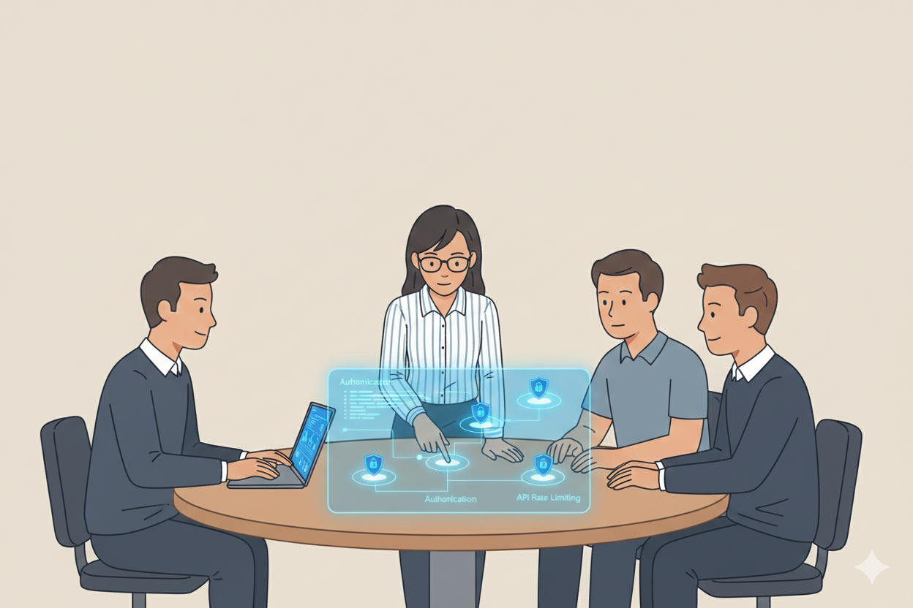
Collaborative Remediation
The Security-Dev Feedback Loop
•
Platform Insights: Share direct links to security issues in the centralized dashboard with development leads.
•
Context-Aware Fixes: Provide clear, copy-pasteable remediation patches tailored to the developer's environment.
•
Continuous Guardrails: Turn resolved issues into custom block-policies directly inside the platform configuration to prevent recurrence.

Slide 8

Severity & Remediation SLAs
Risk Severity | Definition / Impact | Remediation SLA | Recommended Action Plan
Critical | Active exploit path from the public internet; remote code execution | 24 Hours | Immediate patch deployment or runtime mitigation block
High | Local privilege escalation, major data leakage without pre-auth | 7 Days | Prioritize in upcoming sprint; assign to tech lead
Medium | Insecure configuration, authenticated abuse of application logic | 30 Days | Add to standard product development backlogs
Low | Minor framework version mismatch, dead-code block security smell | 90 Days | Evaluate and resolve during scheduled library upgrades

Slide 9
Hands-On SAST Demo
Applying Triage and Scanning Concepts with Semgrep and OWASP Juice Shop

Slide 10
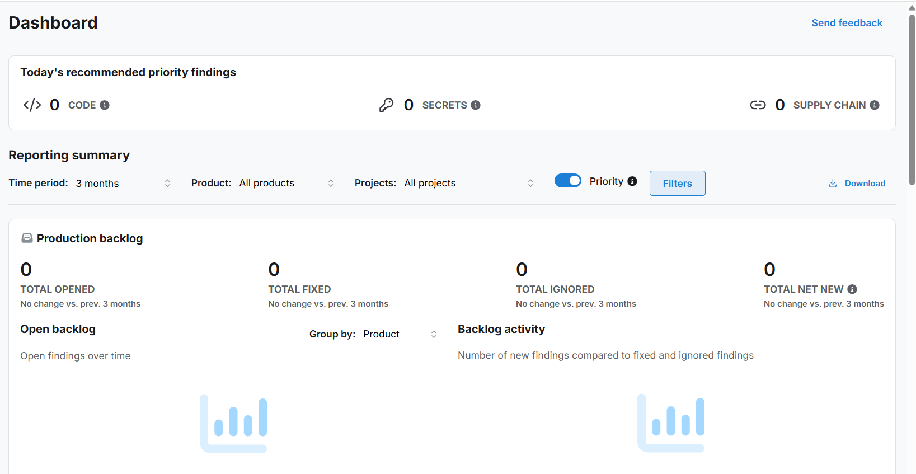
Lab Architecture
Local Targets, Cloud Insights
Our lab connects a local dockerized instance of a vulnerable target (OWASP Juice Shop) with a centralized SAST web portal.
Findings are analyzed locally with Semgrep and synchronized directly to the web interface for unified triage, rule customization, and remediation exercises.

Slide 11






Connection Steps
1. Run Juice Shop
2. Setup Dashboard
3. Scan & Sync
Launch the vulnerable OWASP Juice Shop locally in Docker: docker run -d -p 3000:3000 bkimminich/juice-shop.
Log in to the SAST web platform, configure your project workspace, and generate your secure access token.
Run the Semgrep engine with your token to scan Juice Shop locally and auto-push findings to your central Web UI.

Slide 12

Web Lab Exercises
Lab Exercise | Objective | SAST Platform Feature | Difficulty
Dashboard Triage | Review and ignore test code vulnerabilities | Triage Status tagging | Easy
Custom Policies | Disable noisy rules on the rule board | Policy Editor interface | Medium
Reachability Map | Verify source-to-sink data paths | Visual Taint Engine | Hard
Integration Flow | Configure Slack alert for high-risk SQLi | Integrations webhooks | Medium

Slide 13


Custom Rule Writing Clinic
Meta variables & Operators
Centralized Policy Distribution
When default patterns aren't enough, we construct custom rules. We utilize meta variables (e.g., $USER_INPUT) to enforce schema controls and track variables from source parameters down to SQL sinks.
Once validated locally, custom rules are published directly inside the centralized policy registry. This immediately rolls them out globally across all active organization projects and CI runtimes with one click.

Slide 14
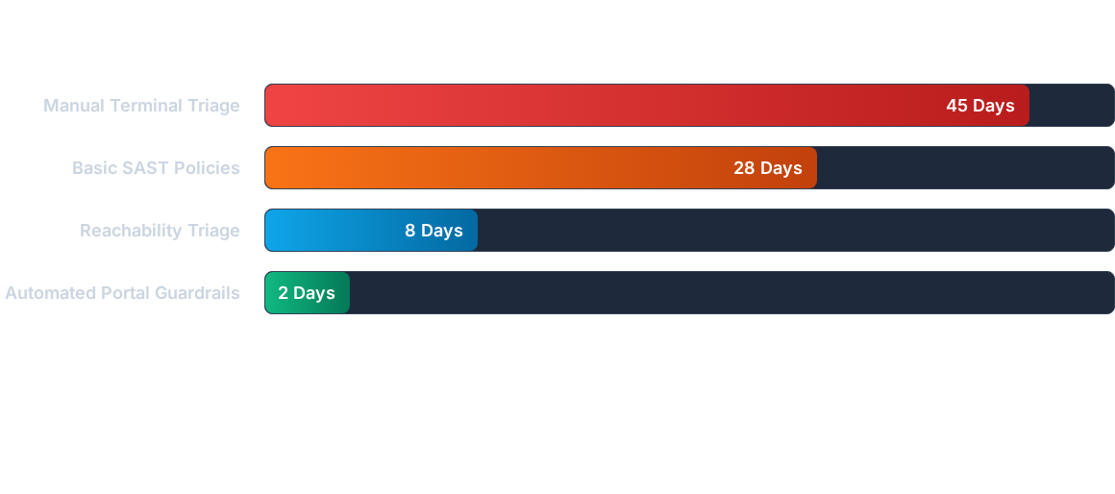
Remediation Success Metrics
Adopting a centralized web portal drastically drops Mean Time to Resolution (MTTR) by avoiding developer pipeline blocks and focusing triage strictly on reachable codepaths.

Slide 15
Questions & Discussion
Secure your applications at dev speed using central AppSec portals

